Slide 1
SNS News Recommendation
임베디드 시스템 연구실
김상모, 김형준, 한인규

Slide 2
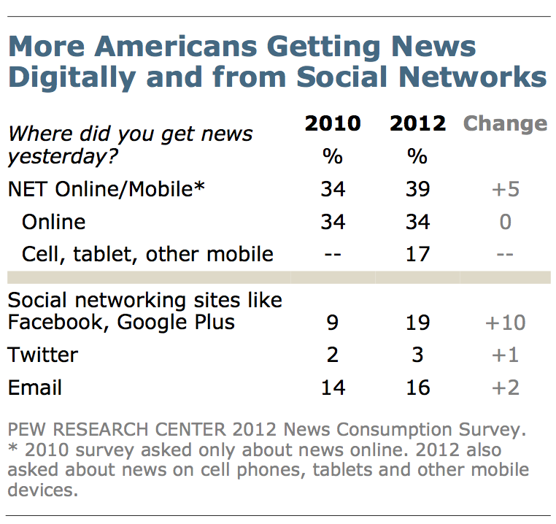
Background
Project Change
“한줄평 분석기” -> SNS News Recommendation
Same Technique: Naïve Bayesian
Growing SNS News Consumption: 9% -> 19% (2010 -> 2012) [2]

Slide 3
Use Case
SNS Feed View (Facebook, Twitter)
Recommends New Status Similar to Previously Liked News (Statuses Contain News Links)
Recommend View
Normal View
(Unfiltered Feed View)

Slide 4
How It Works
Training
Only Lexical Analysis and Document Vector Measurement Took Place
No “Classification” Technique Applied
User Liked News Links
User Liked News Links
Personalized
Document Vector List
Document Vector

Slide 5
How It Works
Recommendation
News Link (New)
Document Vector
Personalized
Document Vector List
N.B.[1]
Recommended!
Score > Threshold

Slide 6
Discussion
No “Classification” : Only List Of “Preferred” Documents (News)
Need to define measurement method of recommendation performance
Study on Google’s Bayesian Framework in Comparison with Naïve Bayesian

Slide 7
References
[1] Personalized News Recommendation Based On Click Behavior
[2] Trend in News Consumption 1991 – 2012, www.people-press.org

